Slide 1

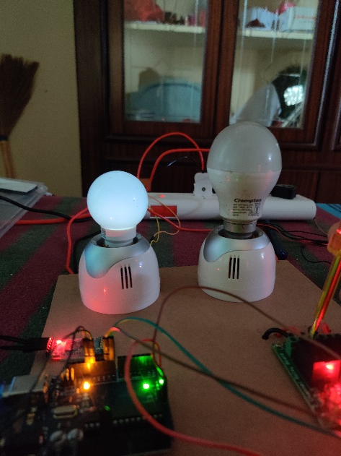
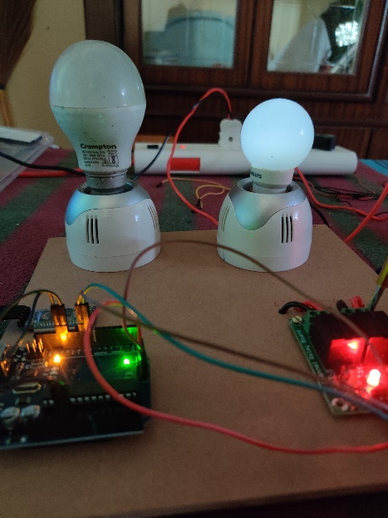
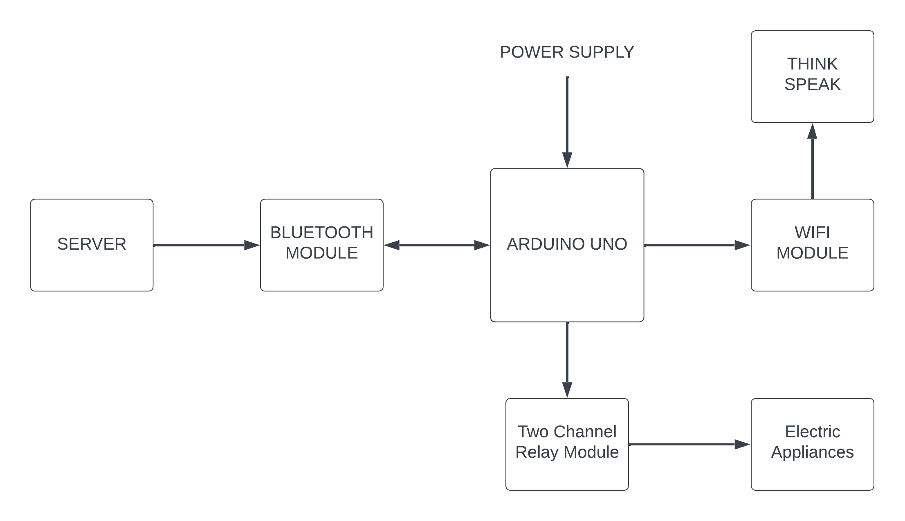
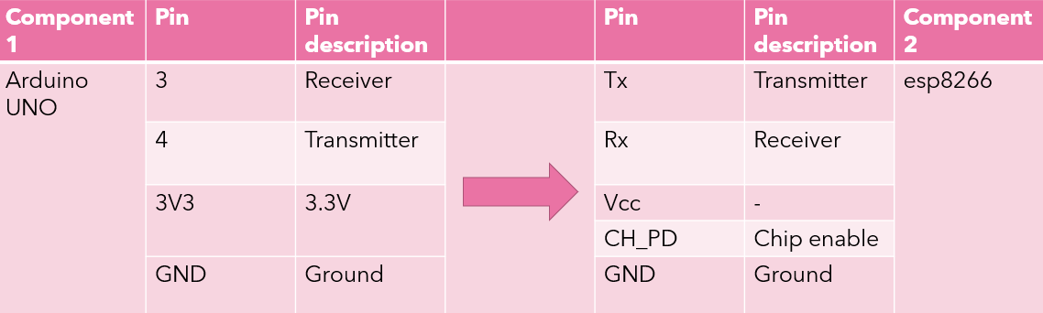
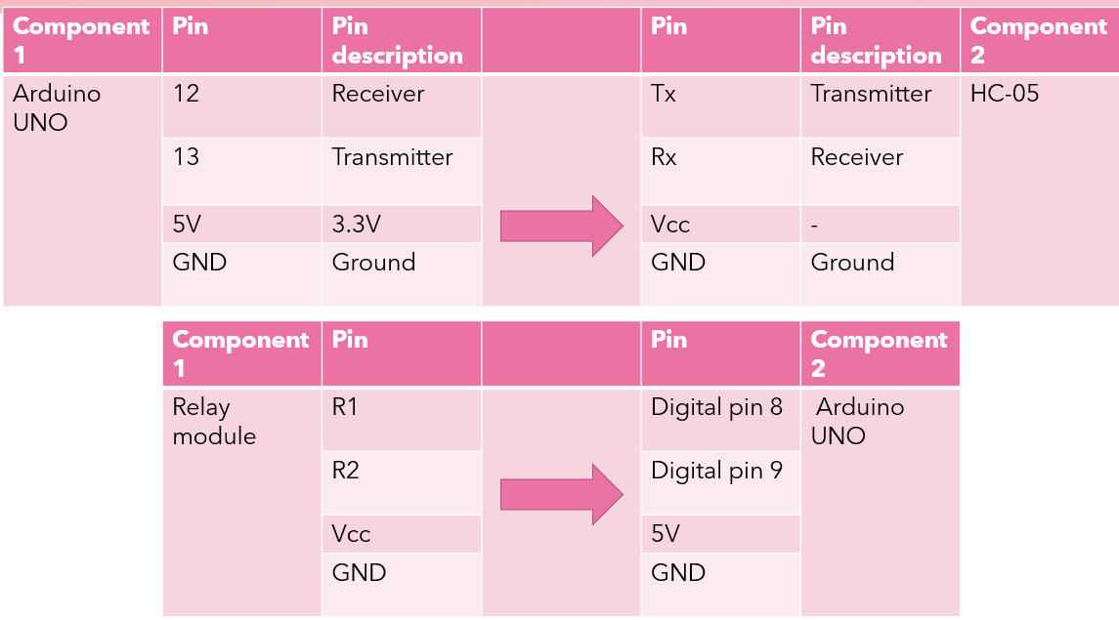
Home Automation Using IoT and Data visualization
Basava Pavan Sriram| Prof.Dr. Arun Kumar Chandrasekhar. | SENSE
Motivation/ Introduction
Results
IoT is all about connecting things over internet to have the required data from many of its applications as, Health, Security, wearables, Data Visualization and Home Automation Home automation is the biggest application over IoT, it is also called as Domotics. Home Automation based IoT, is to automate household activities(such as lighting control, security, temperature monitoring, energy optimization) which is done by interfacing electronics and preferable communication protocols, And by interfacing it with internet we can also use them for Data visualization
Fig 4 Fig 5
SCOPE of the Project
This Internet of Things (IoT)-based home automation project aims to build a smart home system capable of automating and controlling many domestic chores like lighting, energy use, etc. The project intends to increase resident comfort, convenience, and safety while lowering energy use and utility expenses. To facilitate smooth integration with current home appliances and gadgets, the project also seeks to develop a user-friendly interface for operating and monitoring the system. The project will concentrate on system adaptation for users' shifting tastes. By supporting the usage of the system and sustainable practices, the project also hopes to encourage environmental preservation, efficiency in household operations, sustainable living and enhances the quality of life.
Fig 1: the block diagram of the system, indicating all the components
Fig 2: the connections made between Arduino uno and esp8266 wifi module
Fig 3: the connections made between Arduino uno , HC-05 Bluetooth module & two channel relay module
Fig 4: the working of light 1
Fig 5: the working of light 2
The data visualization can be done by using thingspeak and from there we can export the data in excel sheets and can be used for data analysis by whom ever developing and more efficient home automation system
Methodology
Fig 1
This project is a prototype of the home automation where it can control the lighting of the bulb such as on and off by having instructions given through Bluetooth, where the inputs come from an app application connected via Bluetooth, this whole project has different hardware parts that we use in our course period. The electrical devices are controlled via the inputs and those inputs are interfaced with the Wi-Fi module to add the data into the cloud and get a graphical representation of the usage of the appliances
Fig 2
Fig 3
Conclusion/ Summary
Home automation refers to the use of technology to control and automate various appliances or devices in home. by automating various aspects of the home, people can save time and energy. This project aims to provide easy automation to places like home, offices and many other places at affordable prices and this is a user-friendly project with easy interfacing and controlling method. Overall, home automation is a growing field with many exciting possibilities and is likely to become increasingly popular as more people become interested in the benefits of smart home technology. in this project we have introduced the event of house management or automation using Arduino and internet of things. this system is suitable for real time home automation and for remotely controlling home appliances. The future applications can be used in different sectors where internet access is available such as industrial automation and management through internet, and with improved security measures can be used in extreme restricted areas
Contact Details
pavansriramx@gmail.com
Acknowledgments/ References
[1] Pavithra D and Ranjith Balakrishnan " IoT based monitoring and control system for home automation " 2015 Global conference on communication technologies (GCCT 2015)
[2] Tushar Chaurasia and Prashanth Kumar Jain "enhanced smart home automation system based on internet of things" 2019 Proceedings of the Third International Conference on I-SMAC (IoT in Social, Mobile, Analytics and Cloud) (I-SMAC 2019)
IEEE Xplore Part Number: CFP19OSV-ART; ISBN:978-1-7281-4365-1
[3] Muhammad Asadullah and Khalil Ullah "smart home automation system using Bluetooth technology" 2017 IEEE.
[4] M. Danita, Blessy Mathew, Nithila Sharma, Namrata Sharon, J. John Paul "IoT based automated greenhouse monitoring system" Proceedings of the Second International Conference on Intelligent Computing and Control Systems (ICICCS 2018)
IEEE Xplore Compliant Part Number: CFP18K74-ART; ISBN:978-1-5386-2842-3

